Slide 1
Memory Systems & Technologies Summary Two main types of memory technology: Static - expensive but fast - does not need refreshing - used by cache Dynamic - cheaper, higher density of storage, but slower – requires refreshing or the information is lost - used by main memory Both types are volatile

Slide 2
Memory
Memory organization, access and timing
Memory chip evolution
Cache Memory

Slide 3
Main Memory
Memory Metrics:
Bandwidth
capacity: how much data can be transferred in a given time
“Peak Bandwidth” is a theoretical efficiency
Latency
delay: time from request for data to when data is available
chip memory organised as 2D matrix
takes time to activate a row, select a column, switch between rows and columns, etc.

Slide 4
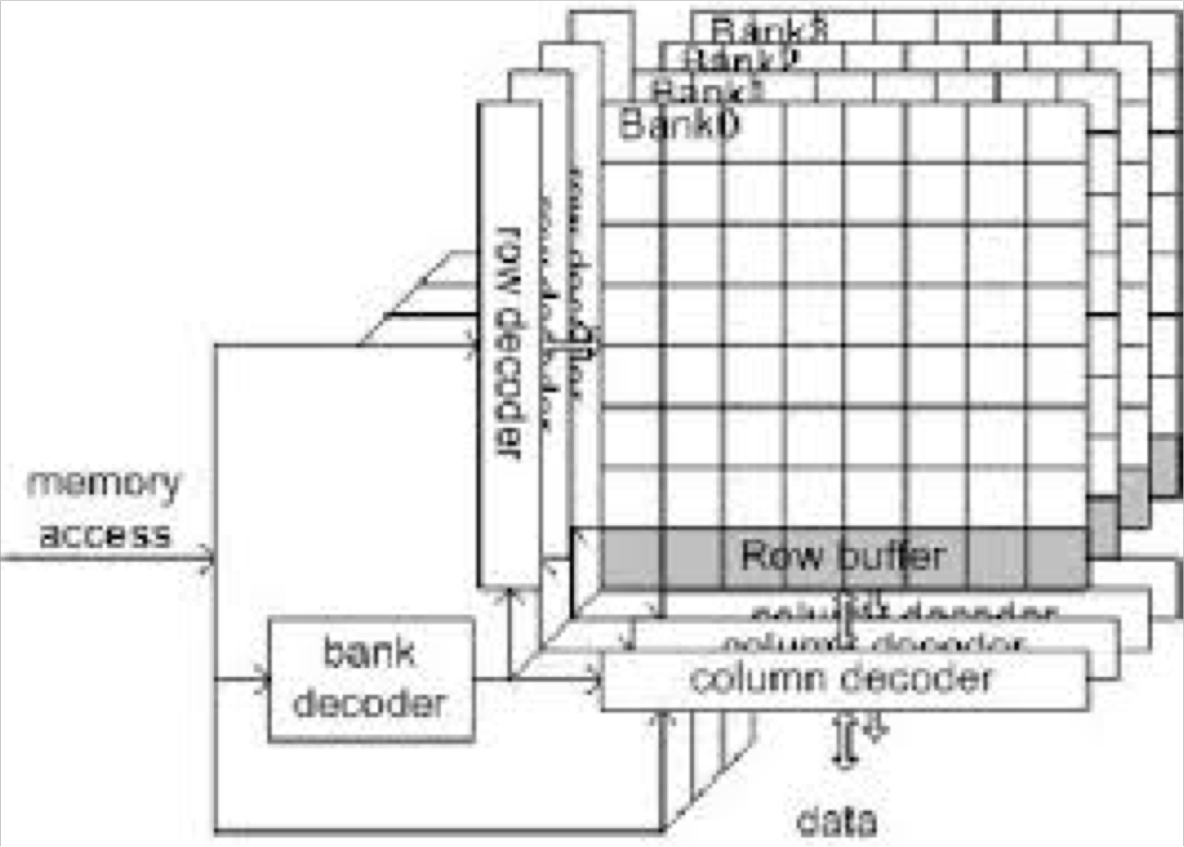
How is Memory Organized and Accessed?
Memory cells are organized into two dimensional arrays called banks
Individual cells are specified by a row and column address

Slide 5

Memory Rows and Columns
E.g. Consider a very simple example using 8 bit addresses (what is the size of the memory?)
The memory address is 01010111
Memory is accessed by row first, and then by column
0101 is the row address
0111 is the column address

Slide 6
Memory Row Column Access
Select the Row- t_{RCD} (in clock cycles)
This causes a read (write) of all data in a given row into a row buffer (column sense amplifiers₁ are used). The time for this to take place is called RAS to CAS Delay or t_{RCD} (RAS to CAS, or Row Address Strobe to Column Access Strobe delay) and is typically specified in number of clock cycles.
Select the Column – CL (in clock cycles)
The row operation selects (opens) the entire row. A read (write) command is sent, again by the memory controller, and the delay before it starts reading is the CAS (Column Access Strobe) latency. 1 The purpose of the sense amplifier is to detect a small differential signal on the bit lines and amplify it in order to identify the data value stored in the selected SRAM cell.

Slide 7
Memory Timing Parameters
Row Precharge – t_{RP} (in clock cycles)
Despite the name, Row Precharge is done when a row of memory is closed. It essentially regularises the charges (which represent 0’s and 1’s) to the correct voltages
These actually change slightly as a result of being read or written
• Row Active Time – t_{RAS} (in clock cycles)
The final value is t_{RAS}, which occurs whenever the controller has to address different rows in a RAM chip. - Once a row is activated, it cannot be de-activated until the delay of t_{RAS} is over.

Slide 8
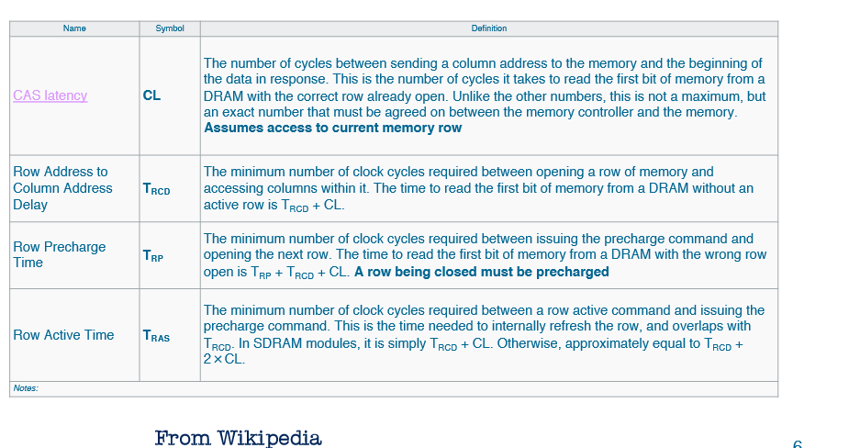
Memory Timing Parameters
Memory timings are normally given as 4 numbers, e.g. 8-8-8-24

Slide 9
Memory Timing Parameters
You cannot assume that the memory bank is ready to be accessed.
When a new row is opened, it means that the previous row must be closed, meaning that both precharge, t_{RP} ,and row active , t_{RAS} , operations need to be performed
Some of these operations can be performed in parallel

Slide 10
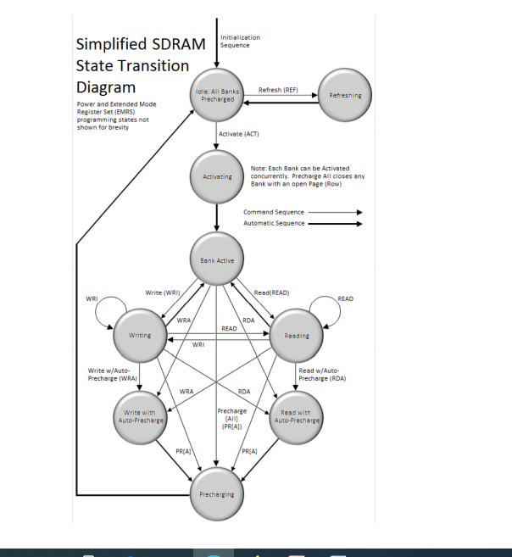
Memory Timing parameters

Slide 11
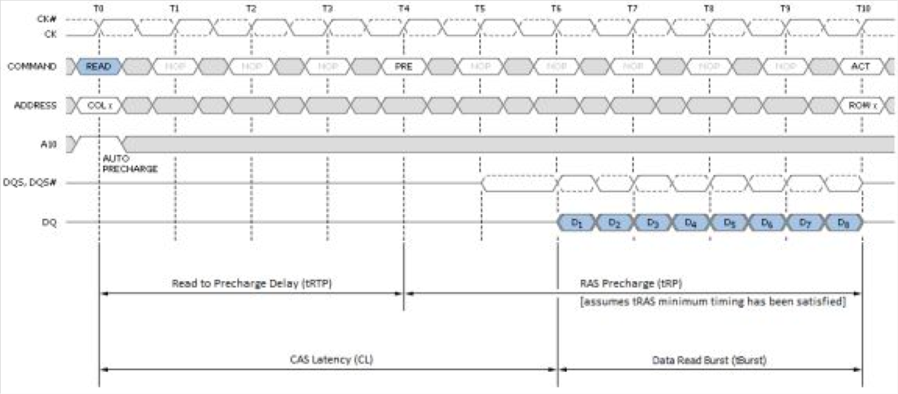
Examples
Assuming 6-6-6-18 timing
If the required data is in the currently opened memory row, access time is CL, i.e. 6 clock cycles
Note clock cycles are in terms of the CPU clock, memory data access is twice this speed –DDR
Timing examples from https://www.anandtech.com/show/3851/everything-you-always-wanted-to-know-about-sdram-memory-but-were-afraid-to-ask/5

Slide 12
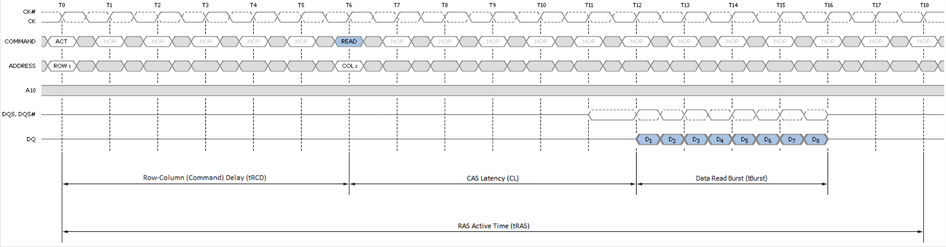
Examples
If the row needs to be opened first, then the access time is
t_{RCD} + CL, i.e. 6+6 = 12 clock cycles

Slide 13
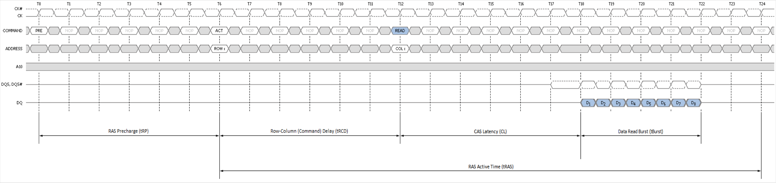
Examples
If another row is open, it needs to be closed first, so the total time is T_{RP} + T_{RCD} + CL = 18 clock cycles

Slide 14
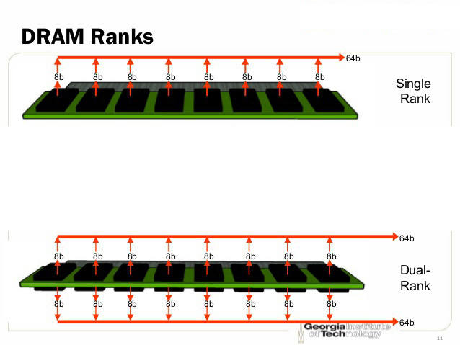
Banks, Ranks
We have only covered the basics here
Not covered: memory banks, and memory ranks
A memory rank is a set of DRAM chips connected to the same chip select, which are therefore accessed simultaneously.
These arrangements allow 8 bytes to be read in each cycle, using additional control lines that we have not discussed

Slide 15
Evolution of SDRAM
Synchronous Dynamic Random-Access Memory (SDRAM)
synchronised with system bus
pipelined: can start work on new request before previous one finished
• SDRAM
- introduced late 1990’s
- ran at 3.3v

Slide 16
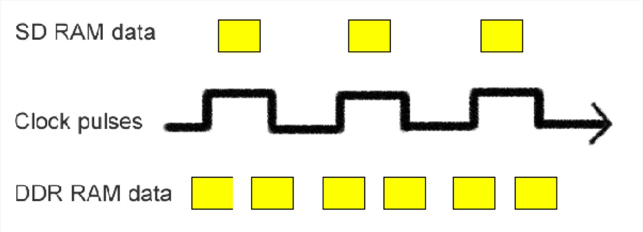
Evolution of SDRAM
DDR SDRAM
Commonly referred to as DDR Ram or DDR1 Ram
The internal clock of the memory modules runs at twice the speed of the CPU clock

Slide 17
Evolution of SDRAM
Typical DDR (also known as DDR1) SDRAM clock rates are 133, 166 and 200MHz, which are described as DDR-266, DDR-333 and DDR-400, because of the double clock rate.
Double clock rate meant that 2 words of data can be read or written every CPU clock cycle.
Voltage reduced to 2.5v, 184 pin chips
Peak bandwidth (burst mode) 3.2Gb/sec for DDR-400 (Memory data bus is 64 bits wide)

Slide 18
DDR2
Minimum read/write unit doubled to 4 words
240 pin chips –mainly additional ground lines
DDR2 SDRAM clock rates are 200, 266, 333 or 400MHz, described as DDR2-400, DDR2-533, DDR2-667 and DDR2-800

Slide 19
DDR3
Minimum read/write unit doubled again to 8 words
Typical DDR3 SDRAM clock rates were 400 and 533MHz, 667MHz and 800MHz, described as DDR3-800, DDR3-1066, DDR3-1333 and DDR3-1600, with DDR3-1600 reaching burst speeds of 12.8 GB/sec

Slide 20
DDR4
Designed spec in 2008, released in 2011/12
Minimum read/write unit 8 words –same as DDR3
Clock frequencies increased again
800 to 2133MHz,
Described as DDR4-1600 through DDR4-4266
Voltage dropped to1.2-1.4v
Peak bandwidth (burst mode) ~3.2Gb/sec for DDR4 -4266 (Memory data bus is 64 bits wide)

Slide 21
DDR5
Specifications still under development.
Some prototypes made
At the moment, the speed of test chips is higher than DDR4, although this is likely to increase further later.
Current forecast is mid 2021
https://www.wepc.com/reviews/ddr5-latest/
https://www.tomshardware.com/news/ddr5-specifications-8400-mhz-cpu-cores

Slide 22
What is all this useful for?
Matching CPU speed to memory speed
Program optimization

Slide 23
RAM speed and PCnnnn ratings
Sometimes memory is described as PCnnnn, eg
PC3200
PC19200
This is the maximum speed in Mbytes/sec that data can be transferred between the CPU and the memory.
However, it will only reach this maximum with the correct CPU clock speed

Slide 24
Examples
A CPU with a “bus” running at 400Mhz can transfer data at a maximum rate of 400 x 10⁶ x 8 = 3200Mbytes/s
A CPU with a “bus” running at 2400Mhz can transfer data at a maximum rate of 2400 x 10⁶ x 8 = 19200Mbytes/s

Slide 25
Examples
Put another way, PC3200 memory will work correctly at ‘bus” speeds of up to 400MHz, and PC19200 will work correctly for “bus” speeds up to 2400 MHz
PC19200 memory would work with a 400MHz “bus”, but only running at 3200 Mbytes/s(excluding other compatibility issues)
The memory will run at generally run at 8 times the speed of the CPU “bus”, providing it doesn’t exceed its maximum speed

Slide 26
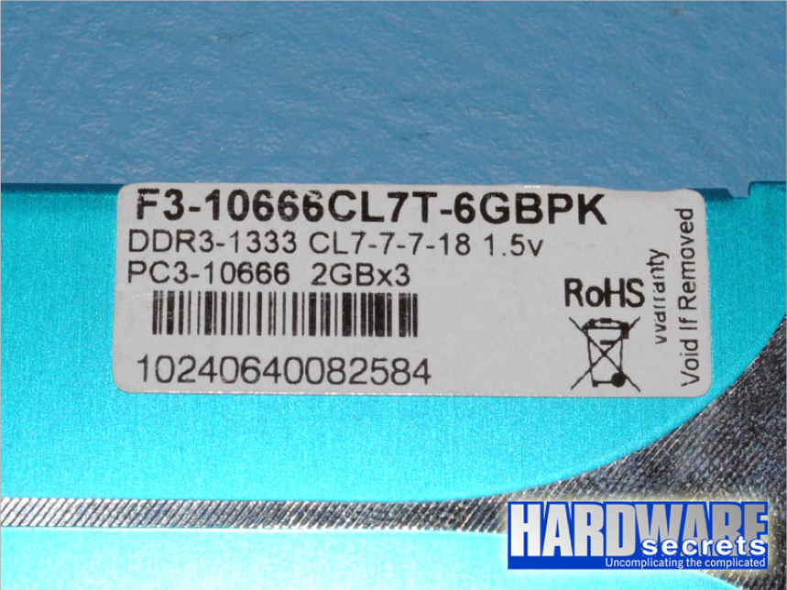
Memory Latency Maximum Burst Speed is the rate data can be transferred to the CPU, but doesn’t take account of latency. • DDR1 SDRAM running at 100MHz (cycle time 1/10⁸ = 10ns), had typical timing of 2-3-3, meaning the CAS delay was 20nS. • What about this one?

Slide 27
Other Bus Structures
Some newer CPUs have dual data buses which potentially double the maximum data transfer rate

Slide 28
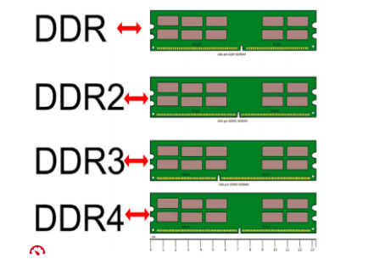
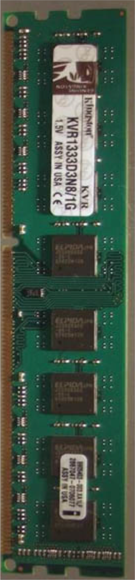
Main Memory
Each SDRAM type has different electrical properties and are incompatible
‘ keyed' so that they will only fit in the socket corresponding to that specific memory technology.
Memory chips are arranged on circuit boards in DIMM (Dual In-Line Memory Module) format
– edge card connectors on both sides of board

Slide 29
Main memory
Example peak bandwidth and speeds:
Technology | Speed Rating | Peak Bandwidth
SDRAM | PC133 | 1.06 GB/sec
DDR SDRAM | DDR-400 | 3.2 GB/sec
DDR2 SDRAM | DDR2-800 | 6.4 GB/sec
DDR3 SDRAM | DDR3-1600 | 12.8 GB/sec
DDR4 SDRAM | DDR4-2400 | 24.8 GB/sec
DDR5 SDRAM | DDR5-6400 | 51.2GB/sec

Slide 30
Non-Volatile Memory
Computers require some information to remain in memory: the BIOS (Basic Input / Output System)
enables computer to access components of hardware
needs to be in memory when computer boots
stored in non-volatile memory
Flash EEPROM
Flash Electrically Erasable Programmable Read Only Memory

Slide 31
Cache
Main memory is slow
If CPU has to wait for a memory access, many CPU cycles are wasted
Cache
static memory between CPU and main memory
holds recently accessed data
holds data predicted to be needed soon (prediction might not be accurate)
multiple levels of cache, L1, L2, L3
initially only L1 was on the CPU, but now L1, L2 and sometimes L3

Slide 32
Cache
Level 1 cache
small (e.g AMD's highly rated Ryzen 5 5600X has a 384 KB L1 cache)
on CPU for ultra fast access
runs at or near CPU speeds so little CPU delay to access
Level 2 cache
larger than level 1 cache (e.g AMD's highly rated Ryzen 5 5600X has a 3 MB L2 cache)
slower than level 1 cache
on CPU
Level 3 cache
larger than level 2 cache (e.g AMD's highly rated Ryzen 5 5600X has a 32MB L3 cache)
slower than level 2 cache
either on CPU or sometimes on a support chip

Slide 33
Cache
Cache is tiny compared to main memory
yet 90% hit rates are not uncommon on modern systems
This is because of the “principle of locality”
Memory Type | Size | Proportion of Total
Main Memory | 16 GB | ~99.9%
Level 3 Cache | 32 MB | ~0.1%
Level 2 Cache | 3 MB | ~0.00003%
Level 1 Cache | 384 KB | ~0.000008%

Slide 34
Cache for Different Purposes
Instruction Cache , Data Cache http://people.cs.pitt.edu/~melhem/courses/1502p/unit6-cache.html
Translation look-a-side cache
The fastest type of cache is content addressable memory - (CAM) is a special type of computer memory used in certain very-high-speed searching applications. It is also known as associative memory or associative storage and compares input search data against a table of stored data and returns the address of matching data.
location | content
1060 | 23
140 | 56
1040 | 42
2020 | 64

Slide 35
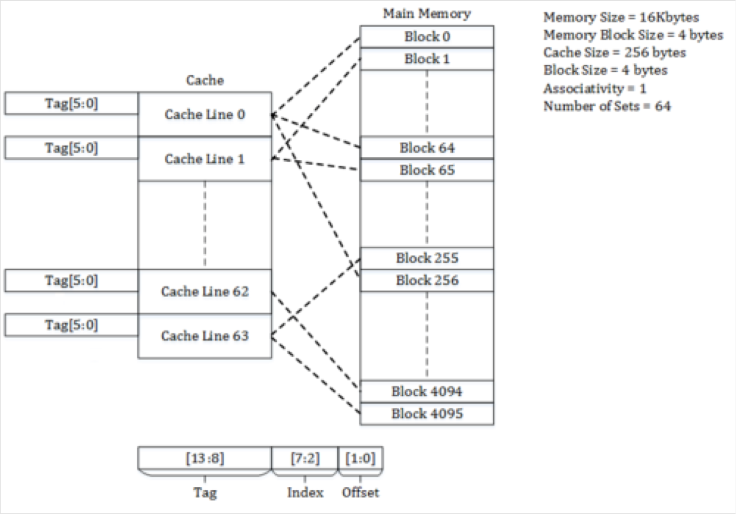
Using Cache
Cache consists of lines, each line has a tag, which is the first location in memory that the data comes from, followed by the data itself

Slide 36
Using Cache
When a memory access occurs the processor first checks the cache to see if cache contains the memory address
If yes, it is loaded directly, this is a Cache hit
If no, Cache miss, the data must be requested from memory, and is loaded into the cache
This also means a new space has to be found in the cache
How this is done is known as the “Cache Replacement Policy”
e.g. least recently used (study more in an Operating System course)

Slide 37
Cache Write Policies
If data is written to the cache, it needs to be written back to main memory at some point, unless it is not changed
When Cache memory address is written to, a status bit is set, marking the location as dirty, meaning it must be written back
Simplest approach is write through, where every cache write is written back to main memory, however this can be slow
Alternatively, cache can be write back, whereby data is periodically written back to memory, or perhaps queued and written back asynchronously when the memory bus is free

Slide 38
Cache Communication
It is common to have dedicated L1 and L2 cache for each core in a multicore CPU
If one core loads a memory location that is currently held in the cache of another core, communication needs to occur to ensure that values are maintained correctly

